Slide 2
Overview of Service Discovery with Cisco Network Service Orchestrator
BRKNMS-2805
Weigang Huang,
Business Development Manager

Slide 3
Introduction
Service Discovery Challenges
Capabilities of NSO
NSO Service Discovery
Discovery Flow
Service Package Development
Service Instance Creation
Service Validation
Service Reconciliation
Demo

Slide 4
About This Session
This session covers
How NSO supports service discovery
Customer use cases
This session is NOT
Product introduction
About basics of NSO/YANG/NET

Slide 5
Introduction Service Discovery Challenge NSO Capabilities NSO Service Discovery Demo

Slide 6

Greenfield and Brownfield
A greenfield project is the installation and configuration of a network where none existed before.
A brownfield project is an upgrade or addition to an existing network and uses some legacy components.
In network, brownfield deployment still requires discovery.

Slide 7

Discovery
The act of finding something that had not been known

Slide 8

Network Discovery
A not very good definition!
“The process through which computers and network devices are able to find each other
”
https://www.techopedia.com/definition/29965/network-discovery

Slide 9
Network Discovery
Network discovery types
Inventory discovery
Physical record of network elements
Topology discovery
Network devices and links, both physical and logical
Service discovery

Slide 10
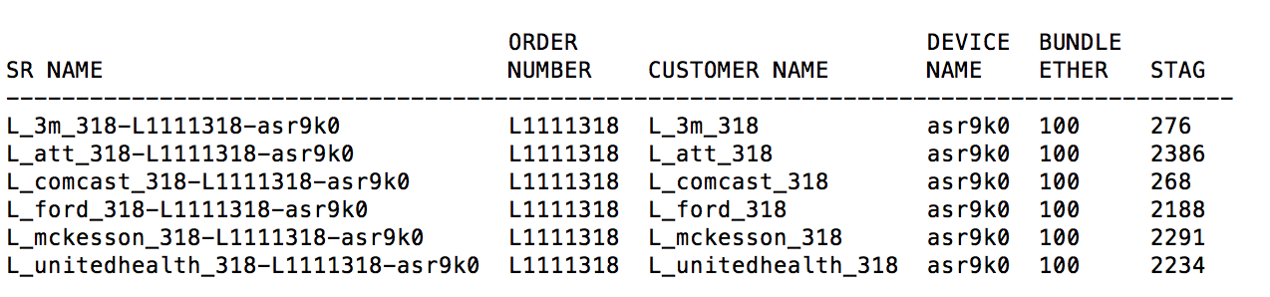

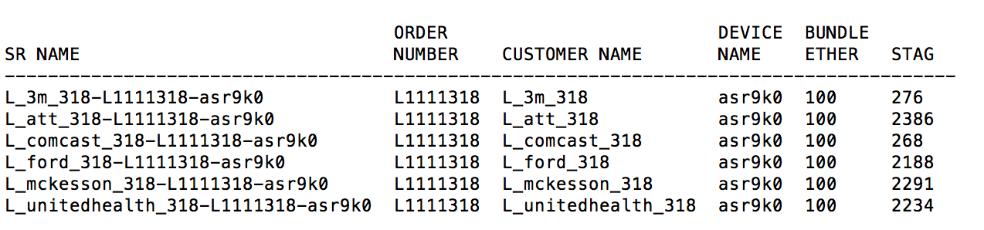

Network Service
A capability that facilitates a network operation.
Service discovery
“The automatic detection of services offered by these devices on a network”

Slide 11
Introduction Service Discovery Challenges Capabilities of NSO NSO Service Discovery Demo

Slide 12
Why Service Discovery?
Provide lifecycle management of existing services
As part of action rolling out new service management tool, migrate pre-existing services into the service management tool.
Perform configuration compliance
Validate network compliance to golden configuration templates
Handle out of band changes
Disaster recovery
Acquisition/Merger

Slide 13


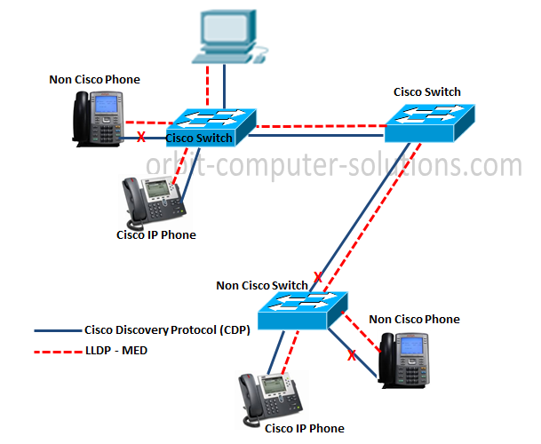
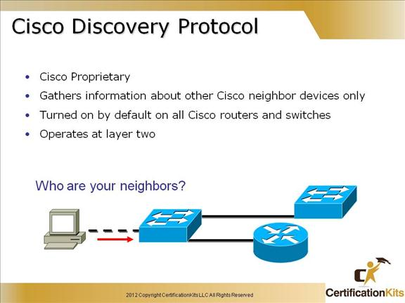




Service Discovery Challenges
Words
Sentences
Articles/books
Inventory discovery
Topology discovery
Service discovery

Slide 14

Service Discovery Challenges
Lack of standards or protocols
Reverse Engineering
Asking: the network is configured to support EVPN for my customers, find me the service instances that are existing
Need accurate requirements and attributes of the services

Slide 15

The Journey Starts From Service Design
Design of service activation for brownfield
Must take into account and coexist with legacy configurations
Model based
Flexible to support multiple iteration with discovery processes
Easy to be “frameworked”

Slide 16
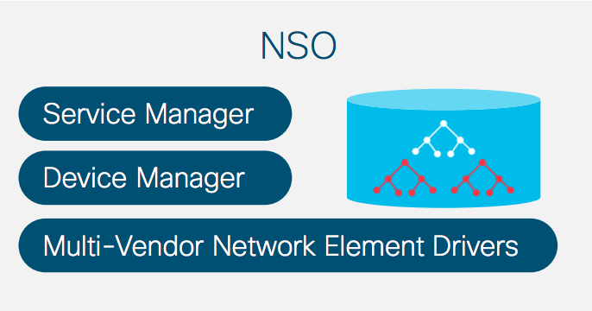
NSO and Service Discovery
Cisco Network Service Orchestrator (NSO)
Network service orchestration framework for multi-vendor networks

Slide 17
Introduction Service Discovery Challenges Capabilities of NSO NSO Service Discovery Demo

Slide 18
NSO Overview
Everything is model (YANG) based!
Supports vendor neutral devices via network element driver (NED)
Transaction based
A service activation platform for both greenfield and brownfield
Supports network service activation/discovery through service packages

Slide 19
NSO Capabilities
Catalog | Capability | Vendor | Support Via
Discovery | Inventory | multi | NED
 | Service Discovery | multi | Service Package
Activation | Device Activation | multi | NED
 | Service Activation | multi | Service Package
Compliance | Service Compliance | multi | Service Package

Slide 20
Service Modeling, Service Activation and Service Discovery
Service activation package defines service model
Service discovery is an add-on capability to activation
The ultimate goal of service discovery
The discovered service instances are managed by service activation package
One model, two capabilities

Slide 21
Introduction Service Discovery and Challenge Capabilities of NSO NSO Service Discovery Demo

Slide 22


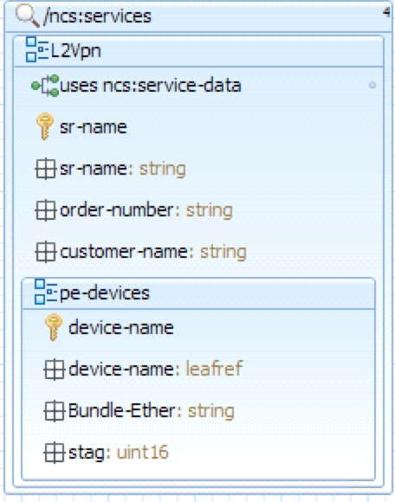
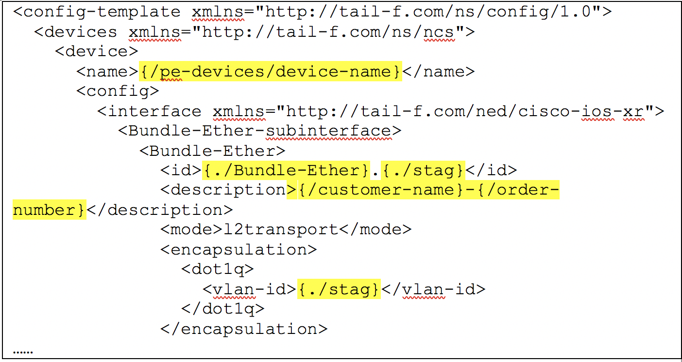
NSO Service Discovery Flow
sync
manage
NSO
NSO device
model
instance
reconcile
NSO service
validate
commit

Slide 23
Introduction Service Discovery and Challenges Capabilities of NSO NSO Service Discovery Discovery Flow Service Package Development Service Instance Creation Service Validation Service Reconciliation Demo

Slide 24
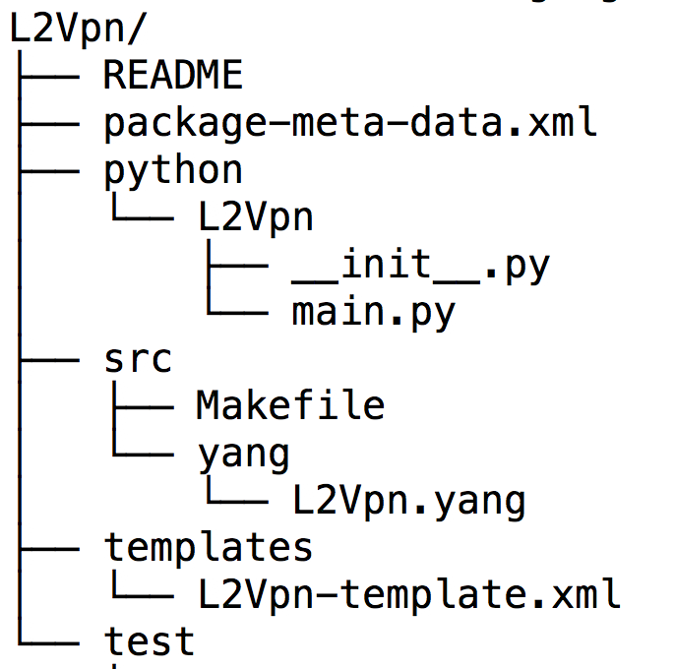
What Makes an NSO Service Package
An example service package
Service YANG model
Templates for service->device mapping
Python/java implementations

Slide 25
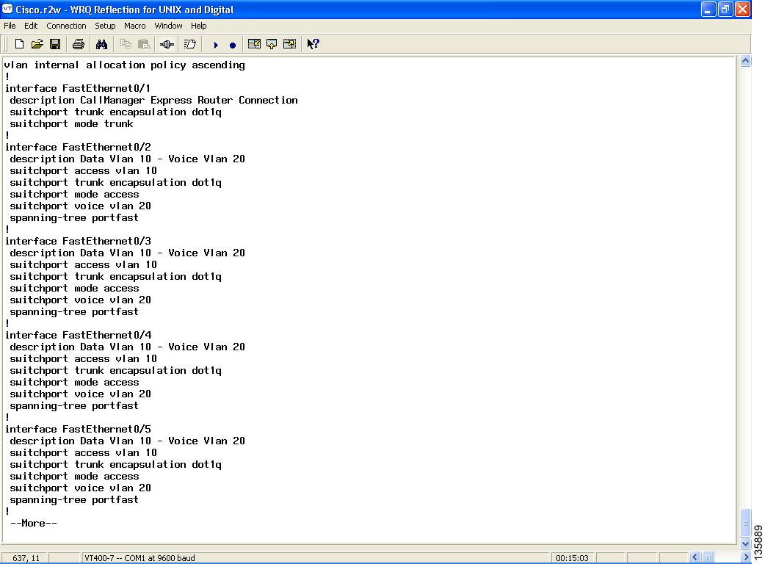
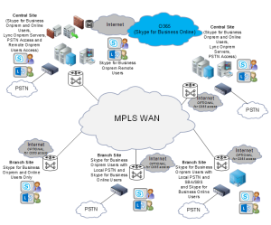
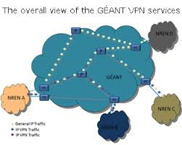
Modeling: Analyze Service Activation Requirements

Slide 26
Parametrize CLI’s to Create Service Attributes
interface Bundle-Ether <PE Port number>.<stag> l2transport
description "<customer name>_<order number>”
encapsulation dot1q <stag>
Service Attributes
Attribute | Type
PE | list
PE port number | integer
service tag (stag) | string
customer name | string
order number | string

Slide 27
Attributes to Service Model – YANG
Attribute | Type
PE | list
PE port number | integer
service tag (stag) | string
customer name | string
order number | string

Slide 28
Mapping: Service Attributes to Device Attributes
Create XML template to plant service attribute as configuration CLI parameters

Slide 29

Deploy Service Packages
NSO

Slide 30
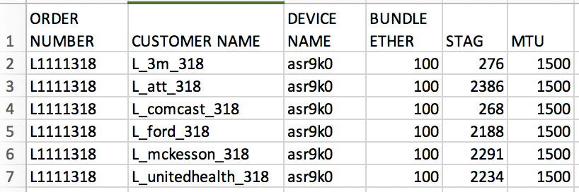
Activate Services
To activate new services, service instances are created using service packages, config CLI’s are sent to network
Service intent
NSO service instances
service activation CLI’s
NSO

Slide 31
Discover Services
To activate new services, service instances are created using service packages, config CLI’s are sent to network
NSO service instances
service configuration
NSO

Slide 32
Introduction Service Discovery Challenges Capabilities of NSO NSO Service Discovery Discovery Flow Service Package Development Service Instance Creation Service Validation Service Reconciliation Demo

Slide 33
User Story A
A service provider builds automation management platform to support mobile backhaul and access control services .
Legacy service situation:
Large set of service attributes and device config data
Service attribute data is well formatted and maintained
Out-of-band operation happens between major service rollout
Disaster recovery scenario must be tested before roll out to production

Slide 34
User Story A
Asking:
Service activation and discovery
NSO solution
Design, develop, and install the activation service packages
Legacy service instances are created from attribute data

Slide 35


User Story A
service attributes
NSO service instances
NSO

Slide 36
Create Services From Legacy Service Data
The service model supports both new and pre-existing service attributes.
Revise service model
Missing and miss typed attributes
Out dated or errored attribute data
Outcome
The activation, discovery, and reconcile fits nicely into the customer’s service rollout process
Service discovery validates the attribute data
service attributes
NSO

Slide 37
User Story B
A service provider supports Ethernet over 3rd Party Vendor services
Multi-vendor environment
Legacy service situation
Multiple teams manage separate function of the network with different legacy tools
Multiple external DB’s maintain legacy service data
Acquisitions
Requires consolidation of service activation methodology

Slide 38
User Story B
Asking:
A cross-functional solution to support service orchestration for their multi-vendor network
Consolidate the legacy services in the network for CRUD operations
NSO solution
Service activation packages for new ethernet services
Legacy service instances creation
First attempt: create service instances from service attribute data
Create service instances from device configuration

Slide 39



User Story B: Service Instances from DB Data?
service attributes
Requires service data manipulation
Outcome
Low successful discovery rate with extra data manipulation effort
Issues with resource management (VLAN-ID)
Discover after acquisition?
service attributes
service data
NSO

Slide 40
User Story B: A Different Approach
NSO maintains model based device configuration for each device
Reverse mapping: create instances from device config
NSO provides API’s to extract attributes from device config
Service instances are created from extracted attributes
Able to manage resource allocation/deallocation

Slide 41
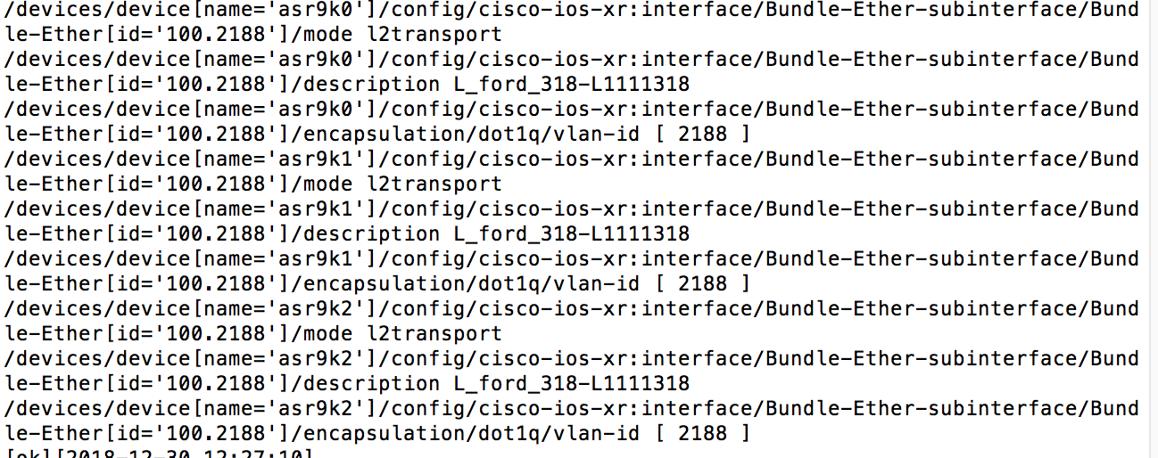
User Story B
device config
NSO service instances
navigate device config to
create service instances
sync-from
NSO device
NSO service
NSO

Slide 42
Device Config of L2VPN Service
Bundle-ethernet configuration, represented as xpath:
admin@ncs% show devices device config cisco-ios-xr:interface Bundle-Ether-subinterface Bundle-Ether 100.2188 | display xpath
/devices/device[name='asr9k0']/config/cisco-ios-xr:interface/Bundle-Ether-subinterface/Bundle-Ether[id='100.2188']/mode l2transport
/devices/device[name='asr9k0']/config/cisco-ios-xr:interface/Bundle-Ether-subinterface/Bundle-Ether[id='100.2188']/description L_ford_318-L1111318
/devices/device[name='asr9k0']/config/cisco-ios-xr:interface/Bundle-Ether-subinterface/Bundle-Ether[id='100.2188']/encapsulation/dot1q/vlan-id [ 2188 ]
/devices/device[name='asr9k1']/config/cisco-ios-xr:interface/Bundle-Ether-subinterface/Bundle-Ether[id='100.2188']/mode l2transport
/devices/device[name='asr9k1']/config/cisco-ios-xr:interface/Bundle-Ether-subinterface/Bundle-Ether[id='100.2188']/description L_ford_318-L1111318
/devices/device[name='asr9k1']/config/cisco-ios-xr:interface/Bundle-Ether-subinterface/Bundle-Ether[id='100.2188']/encapsulation/dot1q/vlan-id [ 2188 ]
/devices/device[name='asr9k2']/config/cisco-ios-xr:interface/Bundle-Ether-subinterface/Bundle-Ether[id='100.2188']/mode l2transport
………….

Slide 43
Navigate Device Config using Maagic API
……….
with ncs.maapi.Maapi() as m:
with ncs.maapi.Session(m, uinfo.username, uinfo.context):
with m.start_write_trans() as t:
try:
root = ncs.maagic.get_root(t)
pe_device = self.getDevice(input.device_name, root)
int_path = '/ncs:devices/ncs:device{%s}/config/cisco-ios-xr:interface/Bundle-Ether-subinterface/Bundle-Ether' %input["device-name"]
……….

Slide 44
Navigate Device Config using Maggic API
sr_path = 'ncs:services/L2Vpn:L2Vpn{%s}' %(sr_name)
sr_node = ncs.maagic.get_node(t, "/ncs:services/L2Vpn:L2Vpn")
obj = sr_node.create(sr_name)
obj.order_number = order_number
……
pe_path = sr_path + '/pe-devices'
pes_node = ncs.maagic.get_node(t,pe_path)
pe_obj = pes_node.create(input.device_name)
pe_obj.stag = bstag
………
srs.append(sr_name)

Slide 45
User Story C
A service provider with multiple service lines
Business customers and consumers
Multi-vendor environment
Legacy service situation
Multiple teams manage separate function of the network with different legacy tools
Long history of legacy services
Management team has low confidence of the correctness of service data
Acquisitions

Slide 46
User Story C
Asking
Provide a scalable orchestration tool to automate customer onboarding services
Legacy services? Find them from network
NSO solution
Service activation packages to roll out customer onboarding services
Service discovery:
Transform the device config to service instances, using XSLT (eXtensible Stylesheet Language)
Key: XSLT style sheet

Slide 47
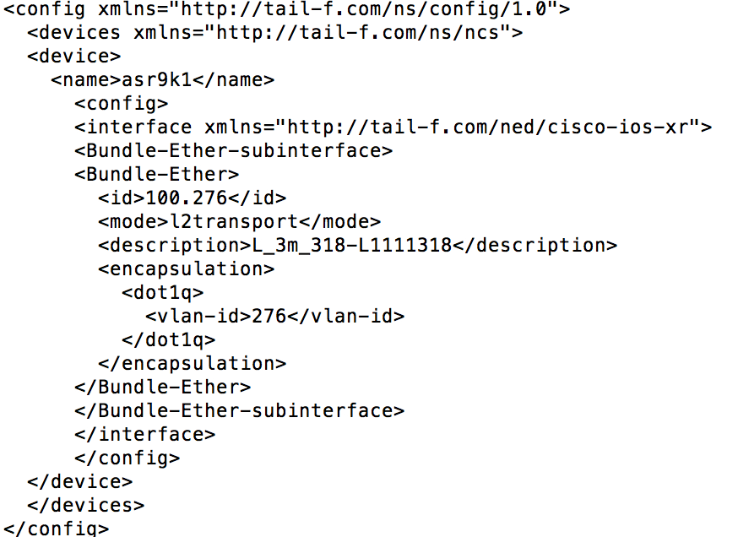
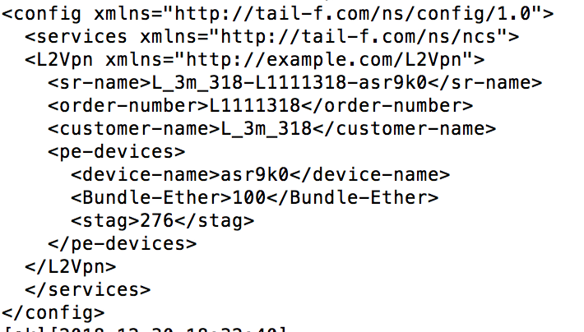
User Story C: Create Service Instances
device config model xml
NSO service instance xml
xslt transform
style sheet
sync-from
import
NSO
NSO device
NSO service

Slide 48
XSLT Stylesheet for L2VPN Services
<xsl:for-each select="x:config/t:devices/t:device/t:config/y:interface/y:Bundle-Ether-subinterface/y:Bundle-Ether">
<L2Vpn xmlns="http://example.com/L2Vpn">
<sr-name><xsl:value-of select=concat("./y:description","y:../../../../t:name"/></sr-name>
<order-number><xsl:value-of select="substring-after(y:description, '-')"/></order-number>
……
<pe-devices>
<device-name><xsl:value-of select="y:../../../../t:name"/></device-name>
……

Slide 49
Create Legacy Services - Summary
Case | Service data | Extra req | Approach | Accuracy
A | Strict formatted | N | service data | H
B | Loosely format | Manage VLAN-ID | normalized service data | L
 |  |  | device model API | TBD (PoC)
C | Not available | N | Device model transform XSLT | H

Slide 50
Create Legacy Services - Comparison
Approaches | Pros | Cons | Suitable Situation
Legacy attributes driven | Low effort | Require high quality of attribute data | Single source, well formatted service attributes
API based device model driving | High accuracy, leverage CDB | Programming skills | Less formatted/missing attribute data
Device to service XML transformation | Light weight | XSLT skills | Less formatted/missing attribute data

Slide 51
“Mistakes are the portals of discovery.”
JAMES JOYCE
https://en.wikipedia.org/wiki/James_Joyce

Slide 52
Introduction Service Discovery Challenges Capabilities of NSO NSO Service Discovery Discovery Flow Service Package Development Service Instance Creation Service Validation Service Reconciliation Demo

Slide 53


Validate the Created Service Instances
Activate services
NSO sends the activation CLI’s to network devices
Discover services:
Create service instances to match those in network
NO configuration CLI’s to network devices.
Key of validation:
Check the net configuration CLI’s generated for discovered services
Empty
Non-empty

Slide 54
Check Service Instances for L2VPN Services
[nso@cl-lab-211 ncs-run]$ ncs_cli -u admin
admin@ncs> conf
admin@ncs% set services L2Vpn test1 order-number L1111318 customer-name L_ford_318 pe-devices asr9k0 Bundle-Ether 100 stag 2188
admin@ncs% commit dry-run outformat native
native {
}

Slide 55
What if the CLI is Not Empty
Validation fails
Revisit service model
Need enhancement?
Revisit the service instance creation process
Enhanced to handle extra cases?
Discuss with management/operation teams:
Error in device configure?

Slide 56
Service Instances Are Committed
What’s next?
The ultimate goal of service discovery:
The discovered service instances are managed by service activation package
NSO
CDB
discovered service instances

Slide 57
Introduction Service Discovery Challenges Capabilities of NSO NSO Service Discovery Discovery Flow Service Package Development Service Instance Creation Service Validation Service Reconciliation Demo

Slide 58
NSO Service Discovery Flow
sync
manage
NSO
NSO device
model
instance
reconcile
NSO service
validate
commit

Slide 59
Configuration Ownership
What?
Why?
To avoid configuration overwritten
How?
NSO uses reference count and back-pointers to keep track of device configuration ownership
NSO service

Slide 60
Configuration Ownership
Reference count of pre-exist configuration starts from 1.
When a service instance is committed, NSO increments the reference count of its configuration, sets a back-pointer to the service instance.
When a service instance is decommissioned, NSO decrement the reference count of the configuration, and remove the back-pointer.
The configuration is removed from devices only when its reference count is 0
Pre-existing config is never removed!

Slide 61
Reconcile: Transfer Configuration Ownership
Make the discovered service instances the owner of the configuration
Enable CRUD operation
How?
Reset reference count of configuration for discovered service instances
Invoke “redeploy reconcile” action
Service reconciliation allows NSO to fully manage the discovered service instances

Slide 62
Why Reconcile?
Green field – activate svc-A
A
Reference count
back-pointer
svc-A
1
NSO service
A
NSO device model

Slide 63
Why Reconcile?
Green field – decommission svc-A
NSO is managing A
A
Reference count
back-pointer
svc-A
1
NSO service
A
nso device model

Slide 64
Why Reconcile?
Brown field – discover svc-B
B
Reference count
1
NSO service
sync-from
B
nso device model

Slide 65
Why Reconcile?
Brown field – discover svc-B
B
Reference count
back-pointer
svc-B
2
NSO service
B
nso device model

Slide 66
Why Reconcile?
Brown field – decommission svc-B without reconcile
B
Reference count
back-pointer
svc-B
2
NSO service
B
nso device model

Slide 67
Why Reconcile?
Brown field – decommission svc-B without reconcile
B is not removed from device
NSO is not managing B
B
Reference count
1
NSO service
B
nso device model

Slide 68
Reconcile to Reset the Reference Count
Brown field – before reset
B
Reference count
back-pointer
svc-B
2
NSO service
B
nso device model

Slide 69
Solution: Reset the Reference Count
Brown field – after reset
NSO is managing B
B
Reference count
svc-B
back-pointer
1
NSO service
B
nso device model

Slide 70
Solution: Reset the Reference Count
Brown field – decommission svc-B after reconcile
B
Reference count
back-pointer
svc-B
1
NSO service
B
nso device model

Slide 71
Reconcile Services Through ncs_cli
Display reference count and back-pointers
admin@ncs% show devices device asr9k1 config cisco-ios-xr:interface Bundle-Ether-subinterface Bundle-Ether| display service-meta-data
……
/* Refcount: 2 */
/* Backpointer: [ /ncs:services/L2Vpn:L2Vpn[L2Vpn:sr-name='demotest'] ] */
Bundle-Ether 100.276 {
/* Refcount: 2 */
/* Originalvalue: l2transport */
………

Slide 72
Reconcile Services Through ncs_cli
Reset reference count
admin@ncs% request services L2Vpn demotest re-deploy reconcile
……
admin@ncs% show devices device asr9k1 config cisco-ios-xr:interface Bundle-Ether-subinterface Bundle-Ether| display service-meta-data
……
/* Refcount: 1 */
/* Backpointer: [ /ncs:services/L2Vpn:L2Vpn[L2Vpn:sr-name='demotest'] ] */
Bundle-Ether 100.276
……

Slide 73
NSO Service Discovery Flow
sync
manage
NSO
NSO device
model
instance
reconcile
NSO service
validate
commit

Slide 74
Can It be Generalized?
sync
manage
NSO
NSO device
model
instance
reconcile
NSO service
validate
commit

Slide 75
Can It be Generalized?
sync
manage
NSO
NSO device
model
instance
reconcile
NSO service
validate
commit

Slide 76
Generalize Service Discovery
discovery framework
service attributes
discovery parameters
sync
create instance
device navigation
style sheet
validate
commit
reconcile

Slide 77
Introduction Service Discovery Challenges Capabilities of NSO NSO Service Discovery NSO Service Discovery and Reconciliation Demo

Slide 78

Demo Case
Network contains legacy L2VPN services
l2vpn
CE1
CE2
PE1
PE2

Slide 79
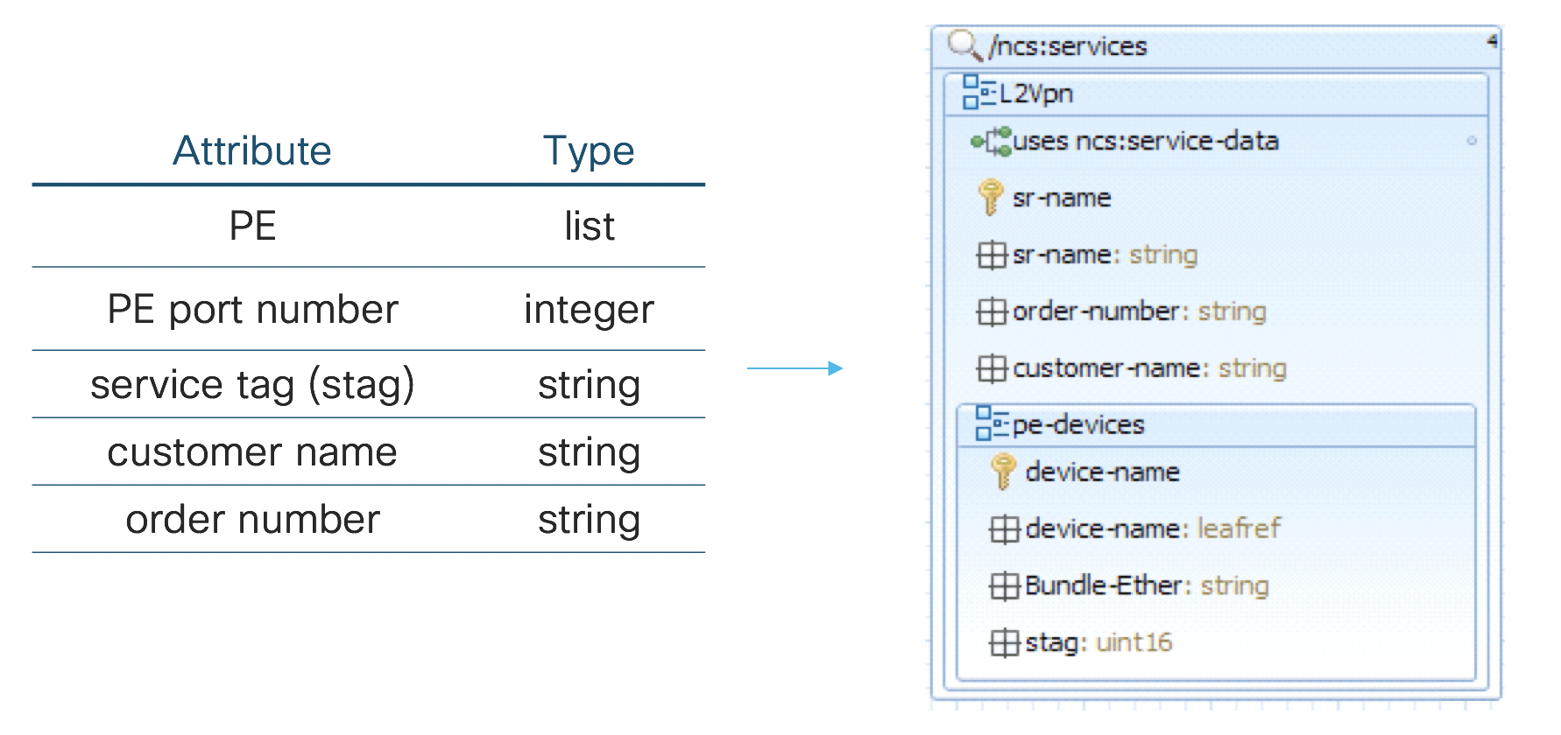
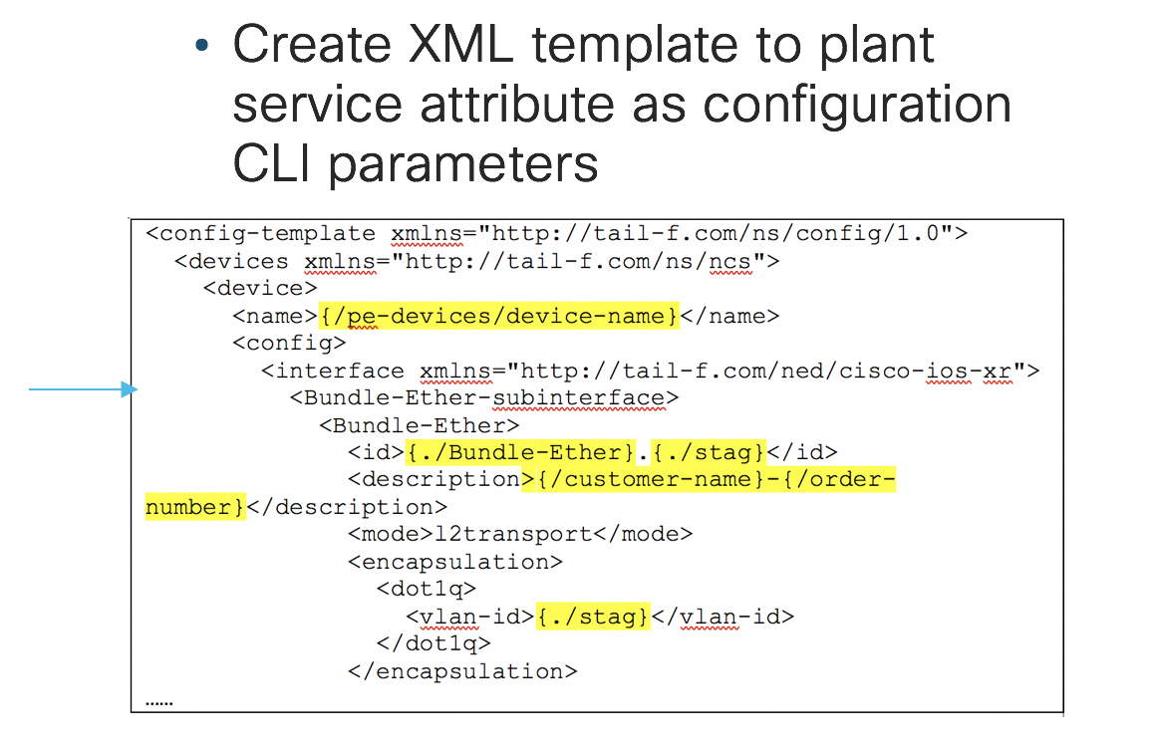
Demo -1
Service package (L2Vpn creation)

Slide 80
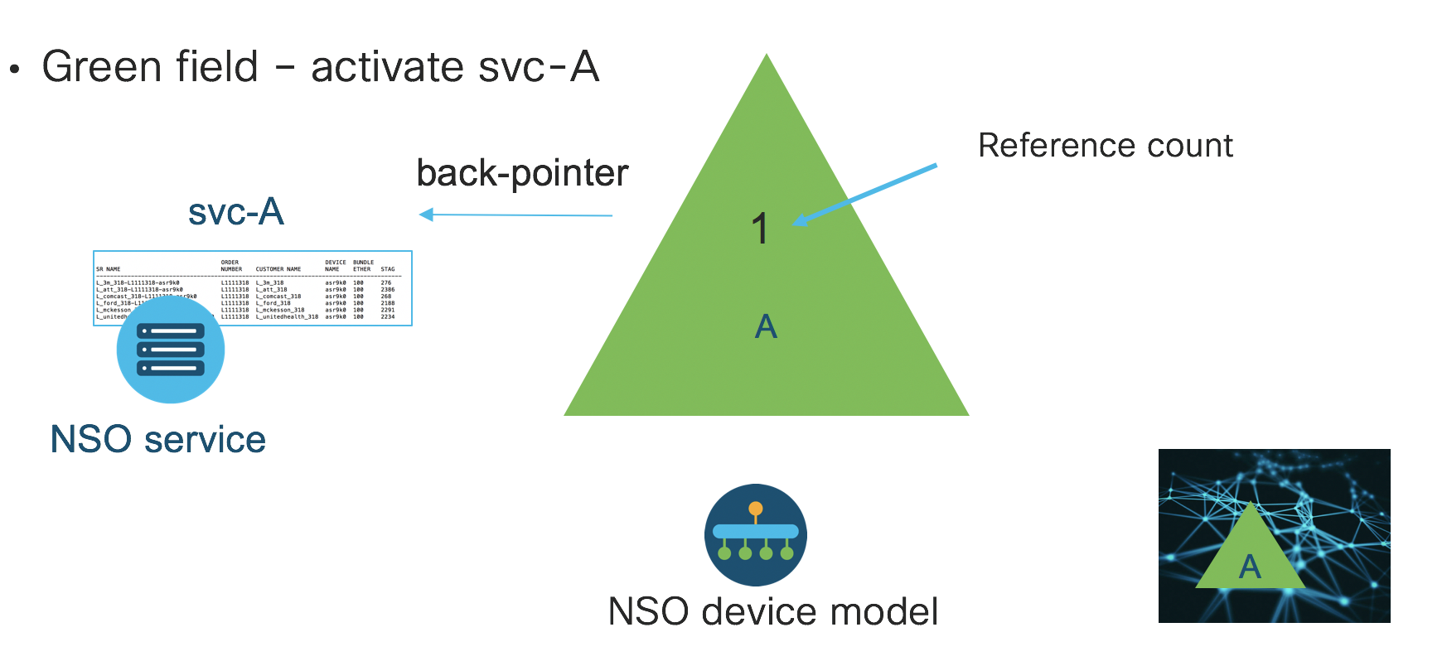
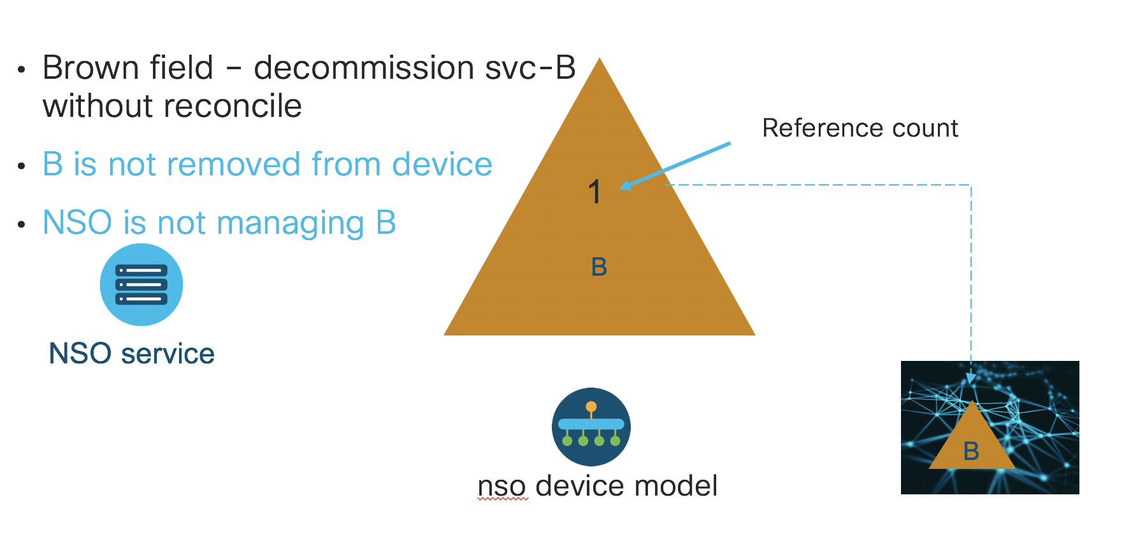
Demo -2
Service reconciliation

Slide 81
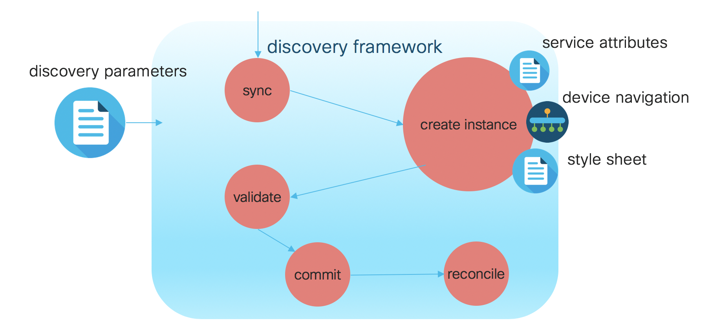
Demo - 3
Automate L2Vpn service discovery

Slide 82
Session Summary

Slide 83
What is the Take Away?
Network service discovery is a journey starts from service design
NSO provides capabilities to automate service activation and service discovery
NSO service discovery can be generalized through service discovery framework package

Slide 84
“There are a lot of services trying to solve the information discovery problem, and no one has got it right yet .”
STEVE CHEN
YouTube LLC, https://en.wikipedia.org/wiki/Steve_Chen

Slide 85
Next Steps

Slide 86
Other NSO or Network Management Sessions
Introduction to Cisco Network Service Orchestrator (NSO) - LABNMS-2011 WISP lab
Cross-domain Orchestration using Cisco NSO - BRKNMS-2470
Wednesday, Jan 30, 2:30 PM - 4:00 PM
DevNet Workshop - NetDevOps Development Environments with Vagrant, VIRL and Cisco NSO - DEVWKS-2680
Wednesday, Jan 30, 1:00 PM - 1:45 PM
DevNet Workshop - Python for Automation with Cisco Network Service Orchestrator (NSO) - DEVWKS-2059
Thursday, Jan 31, 5:00 PM - 5:45 PM

Slide 87
cs.co/ciscolivebot#BRKNMS-2805

Slide 90
Action Steps
Go through LABNMS-2500:
https://github.com/weiganghuang/labnms-2500
Develop, deploy, and test an activation service pack
Observe service discovery issues
Develop, deploy, and test a discovery service pack
Pick your own use case for service activation and discovery

